Slide 1
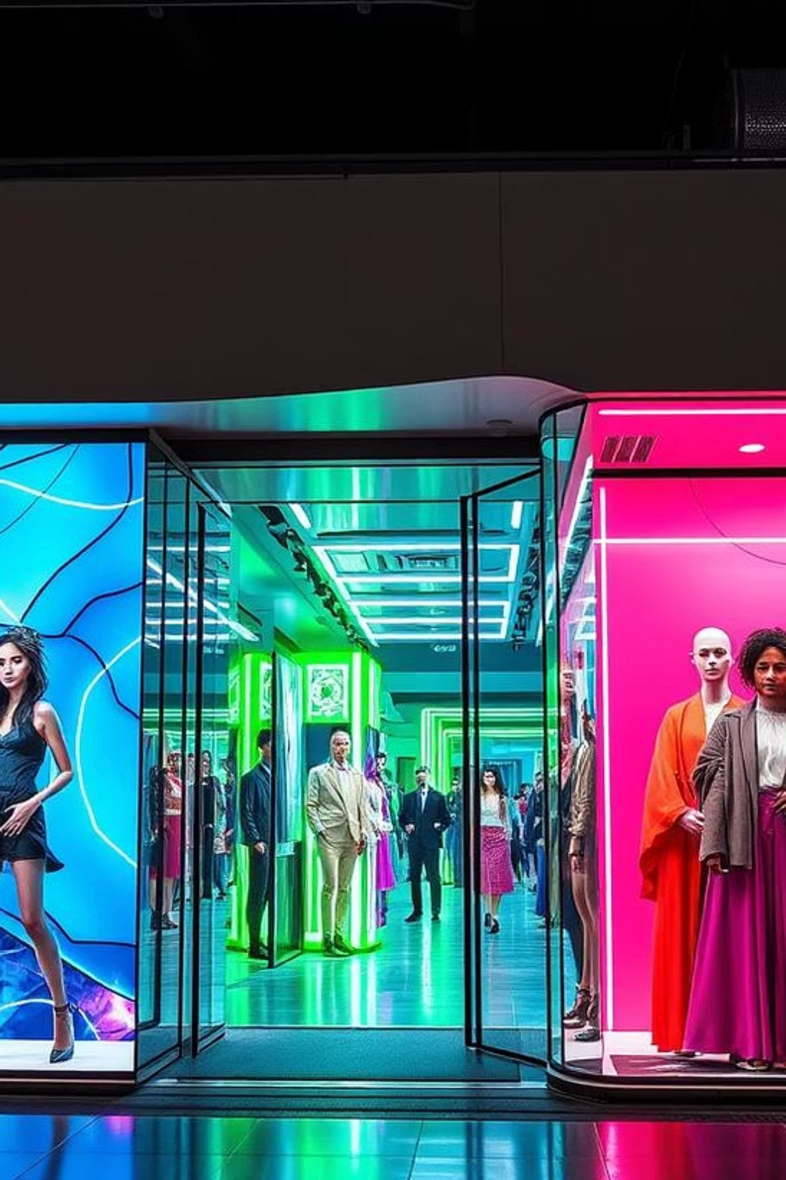
Classifying Fashion Images with Machine Learning
Shadi Farzankia
107209
Shruti Pashine
106369
Hemant
106007
Dharampal Singh
106316
https://github.com/AadrianLeo/Fashion-Style-Classifier

Slide 2

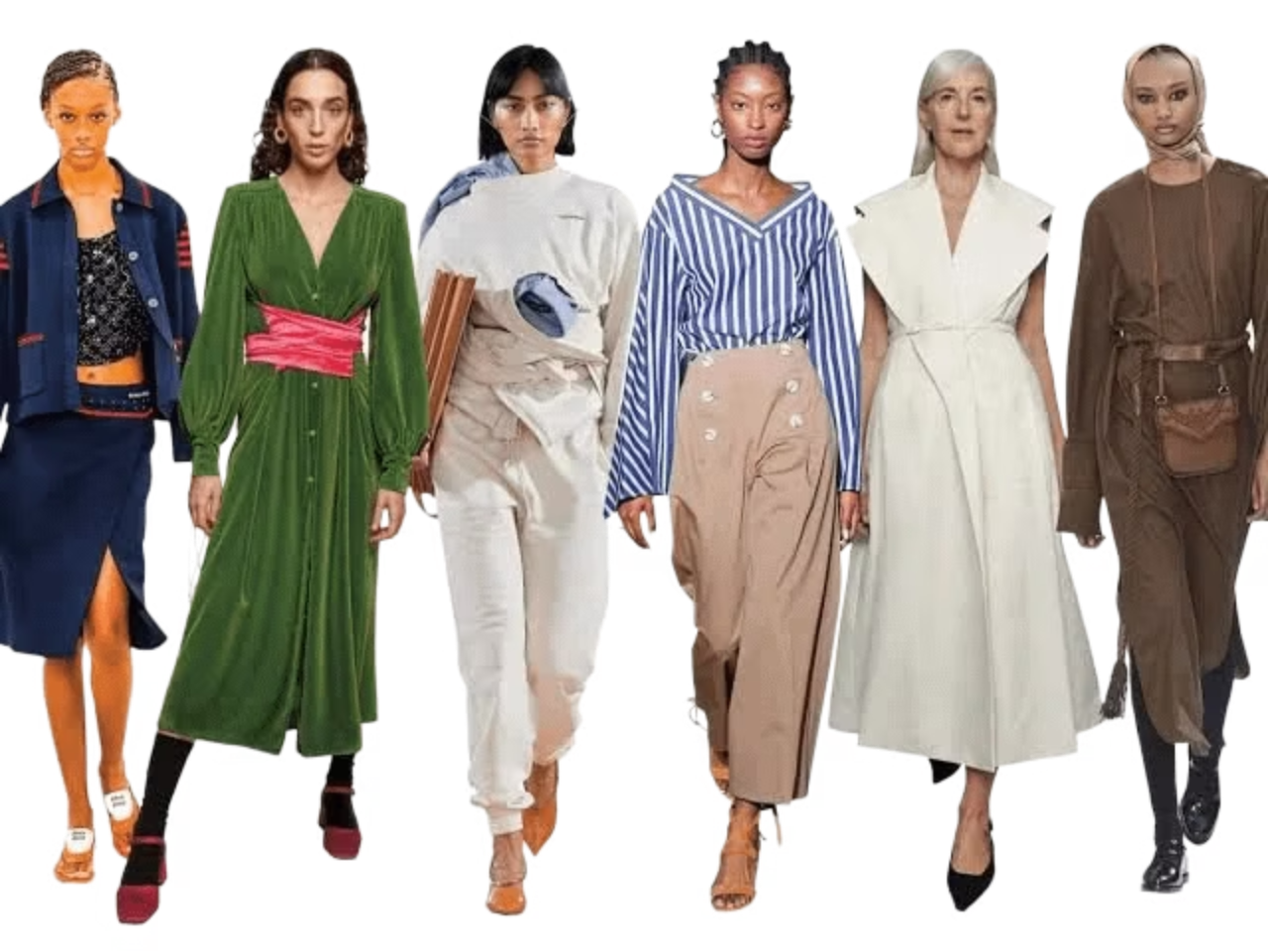
Main Goal
Classify Fashion related dataset into 5 Categories:
StreetWear
Formal
Vintage
Sporty
Casual
Motivation
Understanding fashion styles helps power recommendation engines, trend analysis, and personalized styling.

Slide 3

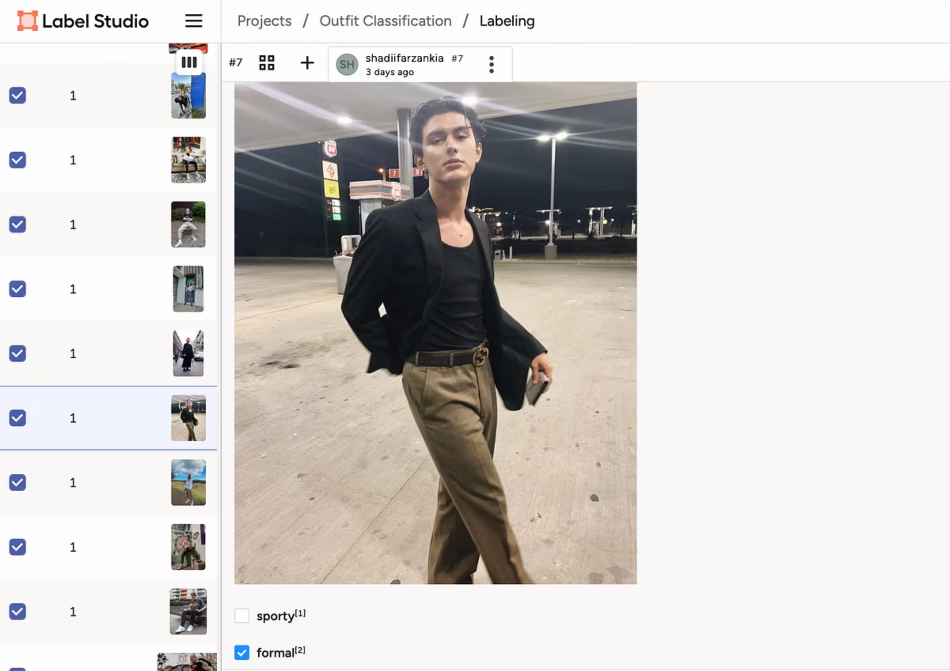
Dataset Details
Used Reddit PRAW API to Obtain Fashion-Related Subreddits
Used hashtags such as #streetwear, #fashion, and #femalefashionadvice
Relevant images were filtered and labeled into 5 style categories using Label Studio
Removed non-fashion content, such as:
Tweet screenshots
Memes or text-only posts
Filtered out images with multiple people to maintain style consistency

Slide 4
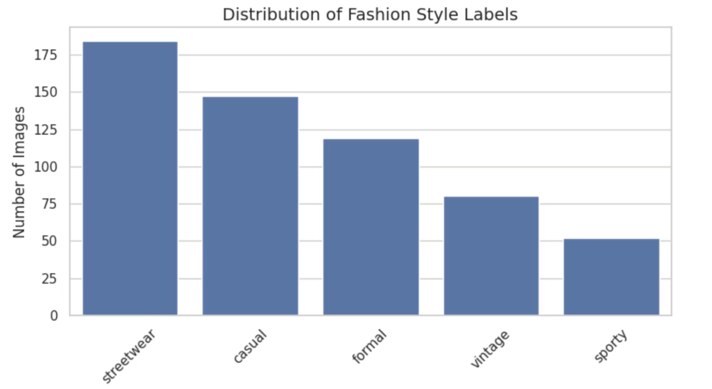
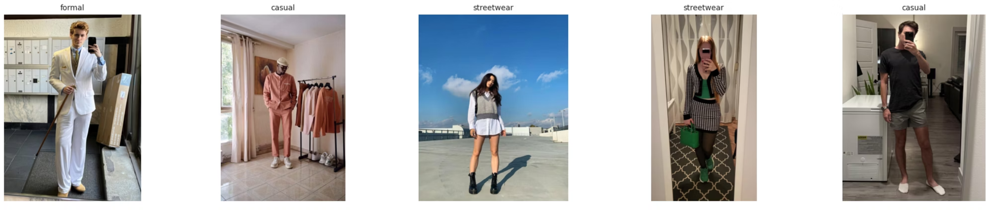
Distribution of the Data
Category
Percentage
Streetwear
31.9%
Casual
25.0%
Formal
20.7%
Vintage
13.8%
Sporty
8.6%

Slide 5


Models Used
Naive Baseline
K-Nearest Neighbors (KNN)
Neural Network (EfficientNet-B0)

Slide 6

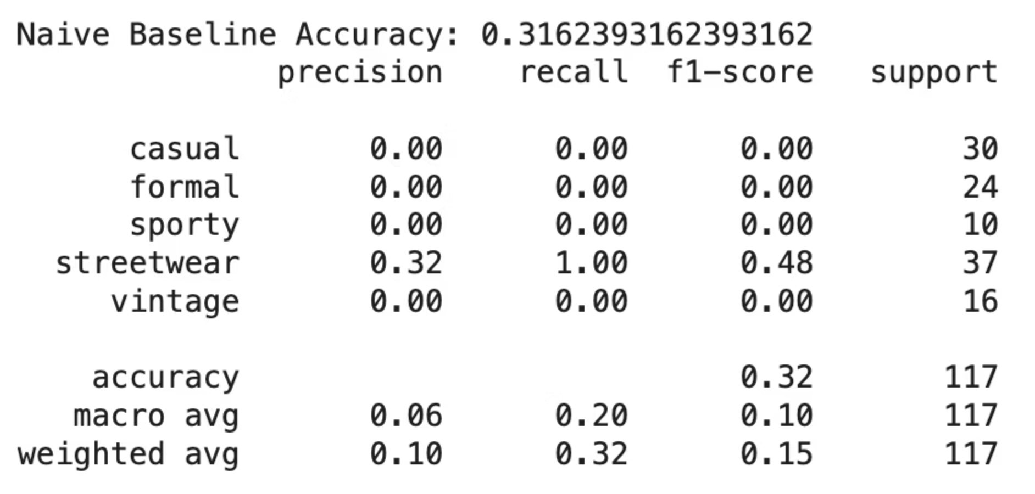
1. Naive BaseLine
predicts the most common class
minimum expected performance
For checking if our models learn anything at all

Slide 7

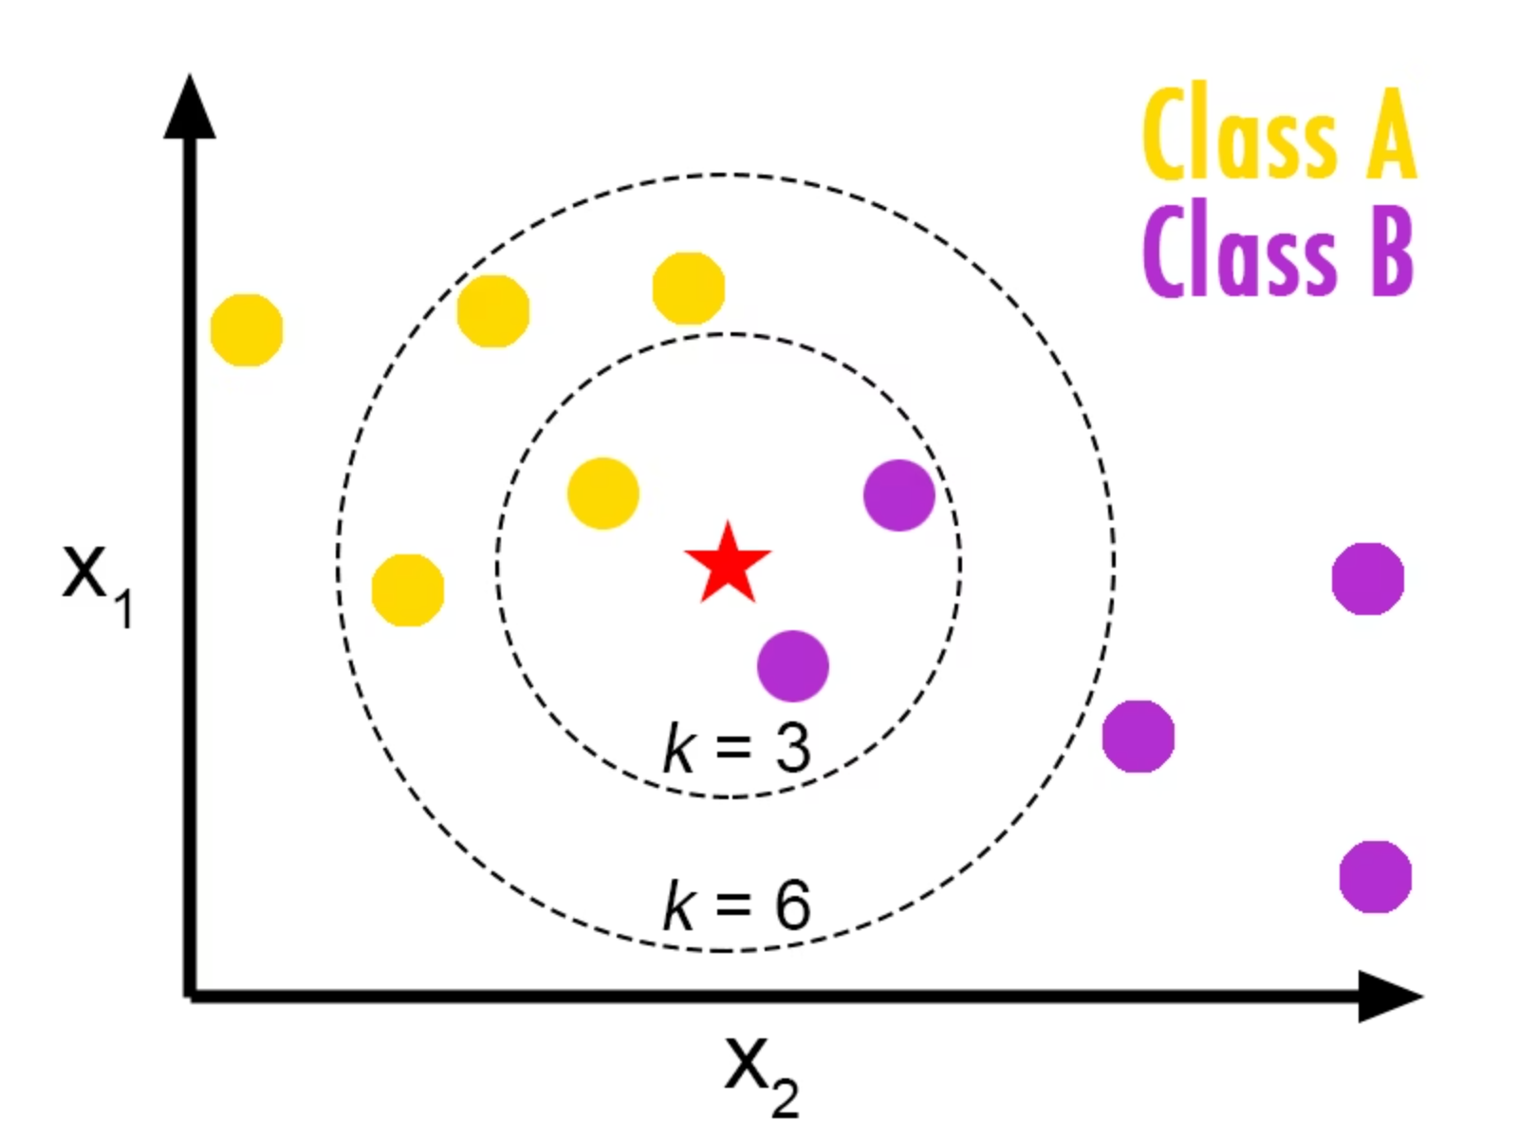
2. K-Nearest Neighbours
a non-parametric algorithm
classifies a sample based on the majority label of its closest training examples in the feature space
pipeline:
Feature Extraction - Extracted deep image features using a pre-trained MobileNetV2 model (without the classification head)
MobileNetV2: Pretrained on ImageNet
Dimensionality Reduction - Applied PCA to reduce the feature space and improve computational efficiency
Keep enough principal components to explain 95% of the variance in the data
Feature Standardization - Used StandardScaler to normalize features for distance-based comparison.
Hyperparameter Tuning - Tuned k and distance metrics using GridSearchCV with 5-fold cross-validation.
Train/Validation Split: Stratified split to maintain class balance.

Slide 8

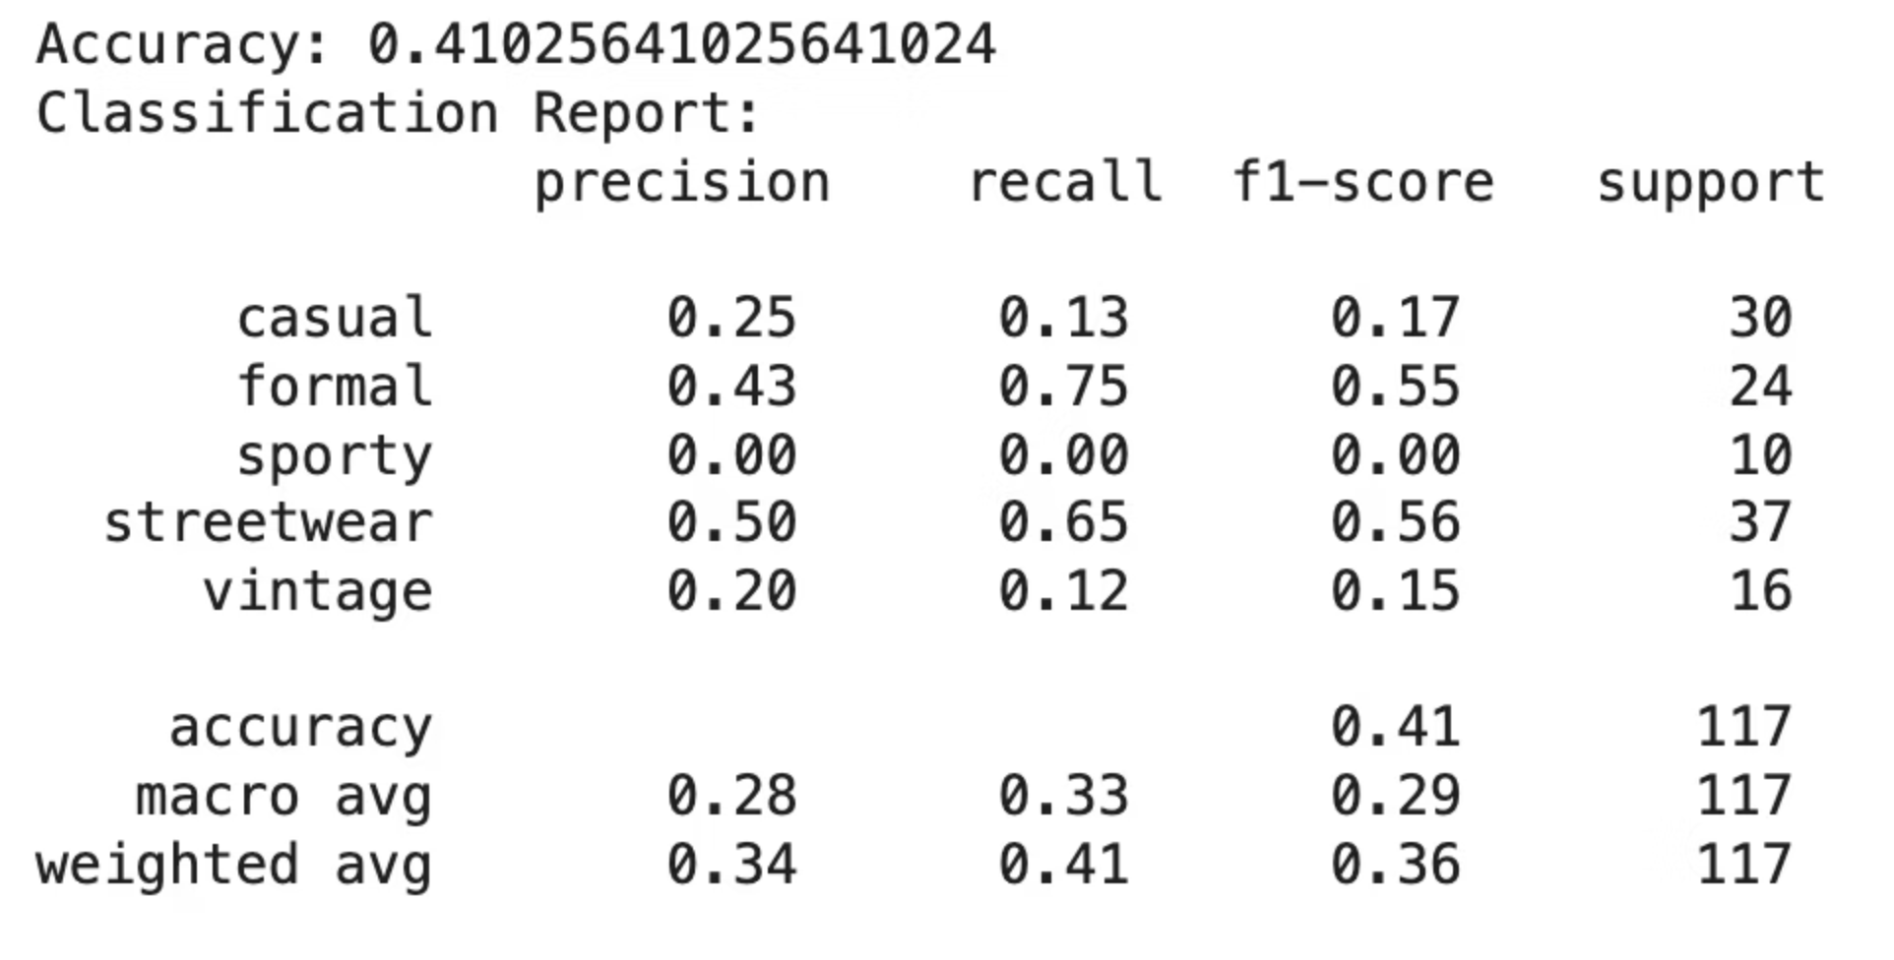
Results for KNN:
Overall Accuracy: 41% — indicates moderate performance
Best Classified:
Formal → F1-score: 0.55
Streetwear → F1-score: 0.56
Worst Classified:
Sporty → F1-score: 0.00
Macro Avg. F1-score: 0.29
Reflects poor performance on minority classes

Slide 9
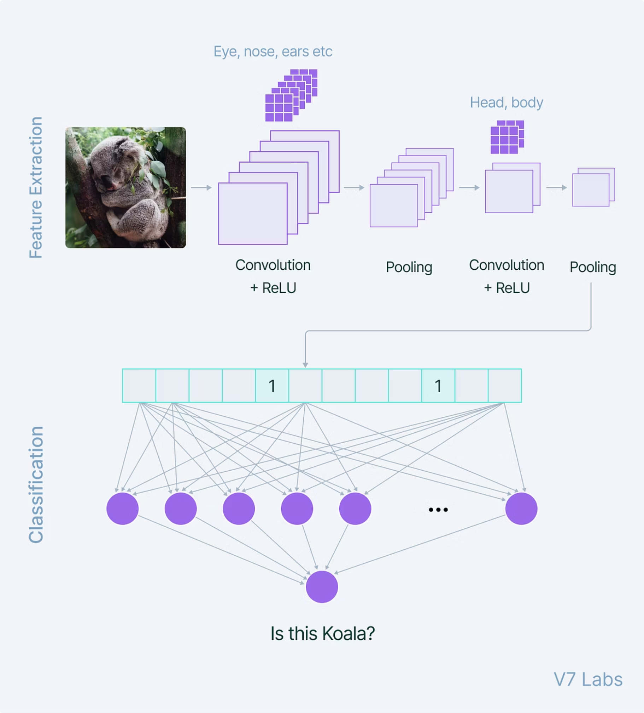
Convolutional Neural Network (CNN)
Model: EfficientNet-B0 (pretrained on ImageNet, fine-tuned on fashion dataset)
Pipeline:
Data Preprocessing: Resized images, applied augmentation (flip, rotation, color jitter), normalized pixel values.
Train/Validation Split: Stratified split to maintain class balance.
Model Architecture: EfficientNet-B0 with custom classification head.
Training: Cross-entropy loss, Adam optimizer, trained for 20 epochs.
Evaluation: Classification report (accuracy, precision, recall, F1-score).

Slide 10

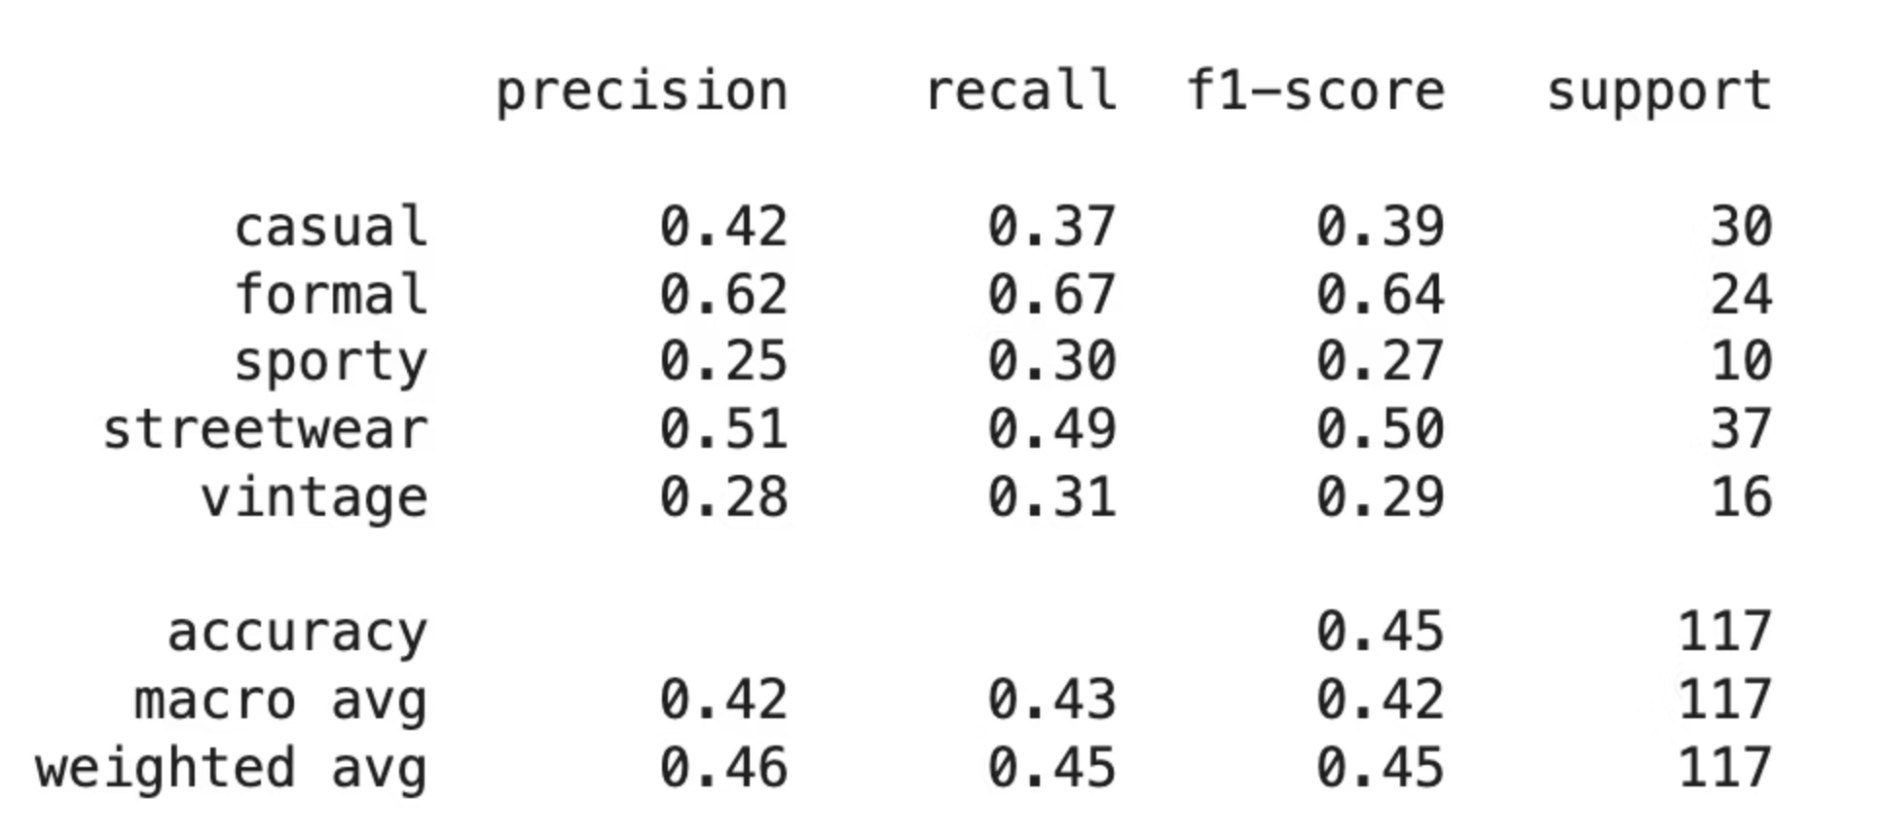
CNN Results (EfficientNet-B0):
Overall Accuracy: 45%
Best Classified:
Formal → F1-score: 0.64
Streetwear → F1-score: 0.5
Worst Classified:
Sporty → F1-score: 0.27
Macro Avg. F1-score: 0.42

Slide 11

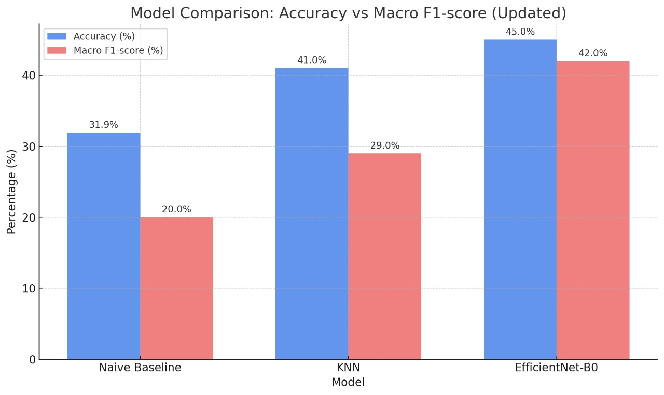
Results Comparison:
Metric
Naive Baseline
KNN
EfficientNet-B0
Accuracy
31.9%
41%
%45
Macro F1-Score
~0.20
0.29
0.42
Best Classified
Streetwear
Streetwear/Formal
Formal/Streetwear
Worst Classified
All but most common
Sporty
Sporty (still low)

Slide 12
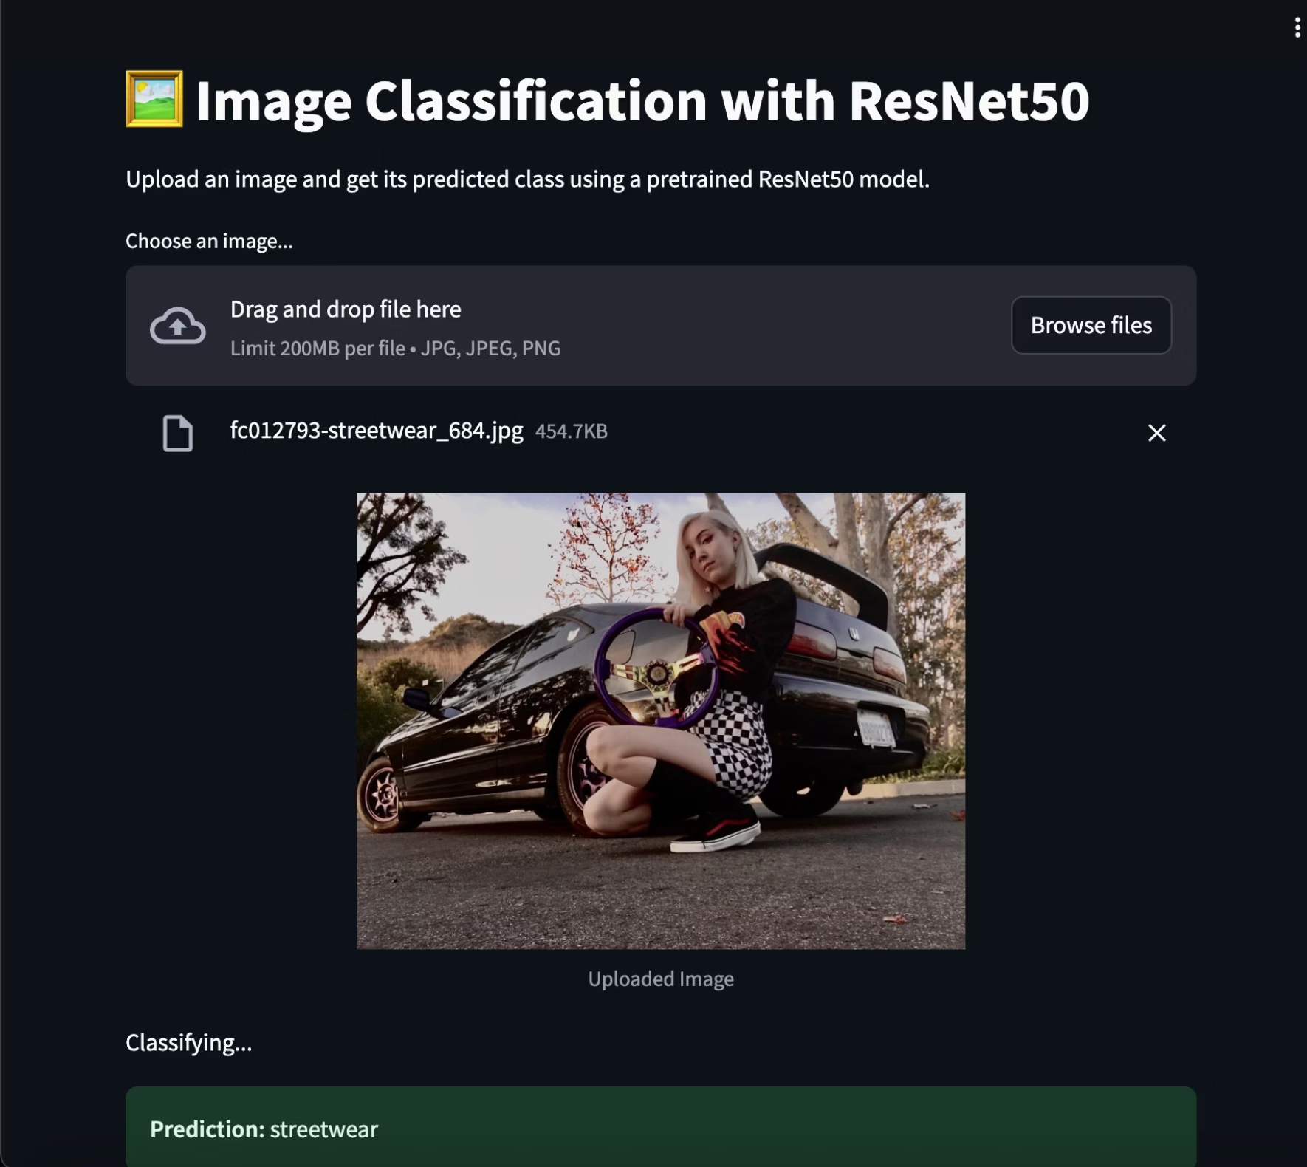
Streamlit App: Predicting Fashion Styles from Images

Slide 13
Future Work:
Expert guidance for more accurate and consistent image labeling.
Apply stronger data augmentation techniques to help balance underrepresented classes.
Use oversampling or generate synthetic images (e.g., with GANs) to improve performance on minority categories.
Expand the dataset with more diverse and balanced fashion images to enhance model generalization.
Tune hyperparameters like learning rate, batch size, and number of epochs to optimize each model’s performance.
Add explainability tools such as Grad-CAM to better understand and visualize how the model makes decisions.

